Slide 1
Mass storage structure

Slide 2
Magnetic disks
Magnetic disks provide the bulk of secondary storage for modern computer systems. Each disk platter has a flat circular shape, like a CD. Common platter diameters range from 1.8 to 3.5 inches. The two surfaces of a platter are covered with a magnetic material. store information by recording it magnetically on the platters.
A read–write head “flies” just above each surface of every platter. The heads are attached to a disk arm that moves all the heads as a unit. The surface of a platter is logically divided into circular tracks, which are subdivided into sectors.
The set of tracks that are at one arm position makes up a cylinder. There may be thousands of concentric cylinders in a disk drive, and each track may contain hundreds of sectors. The storage capacity of common disk drives is measured in gigabytes
Disk speed has two parts. The transfer rate is the rate at which data flow between the drive and the computer.
The positioning time, or random-access time, consists of two parts: the time necessary to move the disk arm to the desired cylinder, called the seek time, and the time necessary for the desired sector to rotate to the disk head, called the rotational latency.

Slide 3
Although the disk platters are coated with a thin protective layer, the head will sometimes damage the magnetic surface. This accident is called a head crash. A head crash normally cannot be repaired; the entire disk must be replaced.
A disk can be removable, allowing different disks to be mounted as needed. Removable magnetic disks generally consist of one platter, held in a plastic case to prevent damage while not in the disk drive. Other forms of removable disks include CDs, DVDs, and Blu-ray discs as well as removable flash-memory devices known as flash drives
A disk drive is attached to a computer by a set of wires called an I/O bus. Several kinds of buses are available, including advanced technology attachment (ATA), serial ATA (SATA), eSATA, universal serial bus (USB), and fibre channel (FC). The data transfers on a bus are carried out by special electronic processors called controllers.
The host controller is the controller at the computer end of the bus. A disk controller is built into each disk drive. To perform a disk I/O operation, the computer places a command into the host controller, typically using memory-mapped I/O ports .
The host controller then sends the command via messages to the disk controller, and the disk controller operates the disk-drive hardware to carry out the command. Disk controllers usually have a built-in cache.

Slide 4
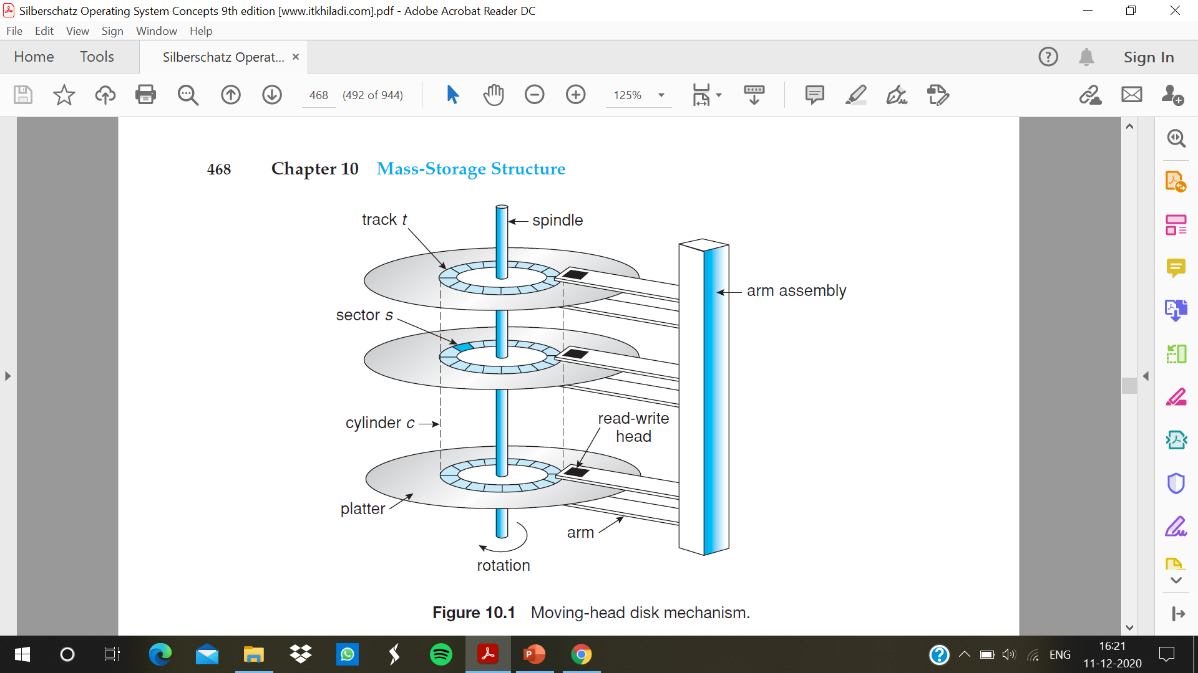

Slide 5
Solid state disks
SSD is non volatile memory that is used like a hard drive. There are many variations of this technology, from DRAM with a battery to allow it to maintain its state in a power failure through flash-memory technologies like single-level cell (SLC) and multilevel cell (MLC) chips.
SSDs have the same characteristics as traditional hard disks but can be more reliable because they have no moving parts and faster because they have no seek time or latency. In addition, they consume less power.
they are more expensive per megabyte than traditional hard disks, have less capacity than the larger hard disks, and may have shorter life spans than hard disks.
One use for SSDs is in storage arrays, where they hold file-system metadata that require high performance. SSDs are also used in some laptop computers to make them smaller, faster, and more energy-efficient.
Because SSDs can be much faster than magnetic disk drives, standard bus interfaces can cause a major limit on throughput. SSDs have no disk head, disk-scheduling algorithms largely do not apply

Slide 6
Magnetic tapes
Magnetic tape was used as an early secondary-storage medium. Although it is relatively permanent and can hold large quantities of data, its access time is slow compared with that of main memory and magnetic disk
random access to magnetic tape is about a thousand times slower than random access to magnetic disk, so tapes are not very useful for secondary storage
Tapes are used mainly for backup, for storage of infrequently used information, and as a medium for transferring information from one system to another.
A tape is kept in a spool and is wound or rewound past a read–write head. Moving to the correct spot on a tape can take minutes, but once positioned, tape drives can write data at speeds comparable to disk drives.
Tapes and their drivers are usually categorized by width, including 4, 8, and 19 millimeters and 1/4 and 1/2 inch. Example: LTO-5 and SDLT.

Slide 7
Disk structure
Modern magnetic disk drives are addressed as large one-dimensional arrays of logical blocks, where the logical block is the smallest unit of transfer.
The one-dimensional array of logical blocks is mapped onto the sectors of the disk sequentially. Sector 0 is the first sector of the first track on the outermost cylinder. The mapping proceeds in order through that track, then through the rest of the tracks in that cylinder, and then through the rest of the cylinders from outermost to innermost.
Logical to physical address should be easy
i) Except for bad sectors
ii) Non-constant # of sectors per track via constant angular velocity

